Slide 1

AI-Powered Adaptive Disaster Management and Intelligent Evacuation Route Recommendation System
Team Members:
2420090047 – Akshaya Vangalapudi
2420030040 – Mikkineni Thanvitha
2420030017 – Allam Greshmica
Guide: G. Lavanya
Department of CSE
A.Y. 2026–2027

Slide 2
Problem Statement
Disasters create changing hazards, road blockages and crowd conditions that complicate evacuation decisions.
Traditional single-factor routing may not explain why a route becomes unsafe or account for destination shelter capacity.
DisasterGuard AI addresses this with a simulated hazard-aware route recommendation engine and a separate LLM-based disaster analysis assistant.

Slide 3
Objectives
1. Disaster Condition Analysis
Use a hosted LLM to summarize supplied simulated incidents, hazards and general precautions.
2. Intelligent Evacuation
Rank predefined demonstration routes using transparent risk and hazard-exposure scores.
3. Adaptive Route Recommendation
Recalculate eligible routes when hazard records or simulated shelter availability change.
4. Improved Decision Support
Display hazard circles, route status, shelter spaces and explainable simulation results.

Slide 4
Existing System
Research Paper: “Adaptive Emergency Evacuation Routing: A Graph-Based Approach”
Authors: Hojat Behrooz, Mohammad Ilbeigi | 2025
Journal: International Journal of Transportation Science and Technology
Approach: Dynamic graph-based emergency evacuation, traffic-flow adjustments and road-network configuration.
Limitation relative to our prototype: Research emphasizes traffic/network optimization; our academic demonstration combines hazard records, simulated shelter constraints, a user-facing map and LLM explanations.
Note: Our implementation is not a real-road-network or real-time emergency navigation system.

Slide 5
Research Gap / Limitations
Research Gap
A user-facing demonstration that combines hazard-aware routing, shelter eligibility and separate AI-generated disaster explanations.
Existing research focus | Our implemented demonstration
Dynamic road-network adaptation | Recompute route scores on request
Traffic-flow optimization | Simulated crowd-density input
Dangerous-to-safe routing | Shelter capacity eligibility
Dynamic routing | Geographic hazard exposure + map
How Our Project Addresses the Gap
Stored simulated hazards + predefined route conditions + shelter capacity
→ Rule-based geographic risk assessment → Adaptive route display
Separate Groq-hosted LLM → Disaster summary, hazards and precautions

Slide 6
Proposed System
DisasterGuard AI is an academic prototype integrating:
• Flask dashboard and disaster-reporting pages
• FastAPI REST endpoints and PostgreSQL hazard/disaster records
• Geographic risk calculations on predefined demonstration routes
• Simulated shelter capacity and blocked-route exclusion
• Leaflet/OpenStreetMap interactive hazard visualization
• Groq API + GPT-OSS 20B for AI disaster analysis
Output: Request-triggered adaptive route recommendations and separate AI explanations.
Scope: Simulated data; not validated for actual emergency evacuation.

Slide 7
Existing vs Proposed
Existing Research / Systems | DisasterGuard AI prototype
Often focuses on one factor | Hazards + crowd + shelter checks
Road-network optimization | Predefined demo route scoring
Traffic-flow focused approaches | Geographic hazard exposure
Research/simulation environments | Flask dashboard + Leaflet map
Separate information sources | PostgreSQL-backed hazard records
Route planning | Route display + separate LLM analysis

Slide 8
Technologies Used
Modern Tools & Technologies:
• Git + GitHub — version control and commits
• Pytest — 18 automated tests passed locally
• GitHub Actions — CI workflow configured (run status to verify)
• Flask — frontend and API proxy
• FastAPI — REST backend and AI endpoint
• PostgreSQL — persistent hazard and disaster records
• Leaflet + OpenStreetMap — geographic visualization
• Groq API / GPT-OSS 20B — hosted LLM analysis
• MAPE-K — conceptual adaptive control model
• Jira/Scrum — include only if documented separately

Slide 9
System Architecture
Flask Web UI: Dashboard • Reports • Map
↓
FastAPI: Disaster • Hazard • Evacuation • AI
↓
PostgreSQL + rule-based geographic routing
Shelter capacity and hazard exposure
Groq API + GPT-OSS 20B
Simulated disaster analysis
↓
Displayed route recommendation + AI analysis
(AI does not select the route)

Slide 10
Modules
1. Disaster Reporting — Flask forms and FastAPI CRUD endpoints.
2. Hazard Zone Management — Store and retrieve simulated hazard records in PostgreSQL.
3. Geographic Risk Engine — Evaluate exposure of predefined routes to hazard zones.
4. Adaptive Evacuation — Rank eligible routes; exclude blocked routes.
5. Shelter Management — Check simulated destination capacity.
6. AI Disaster Analysis — Groq-hosted GPT-OSS 20B generates text explanations.
7. Map Visualization — Leaflet shows hazard circles, route markers and shelter status.
8. Testing and Version Control — Pytest, Git/GitHub, GitHub Actions workflow.

Slide 11
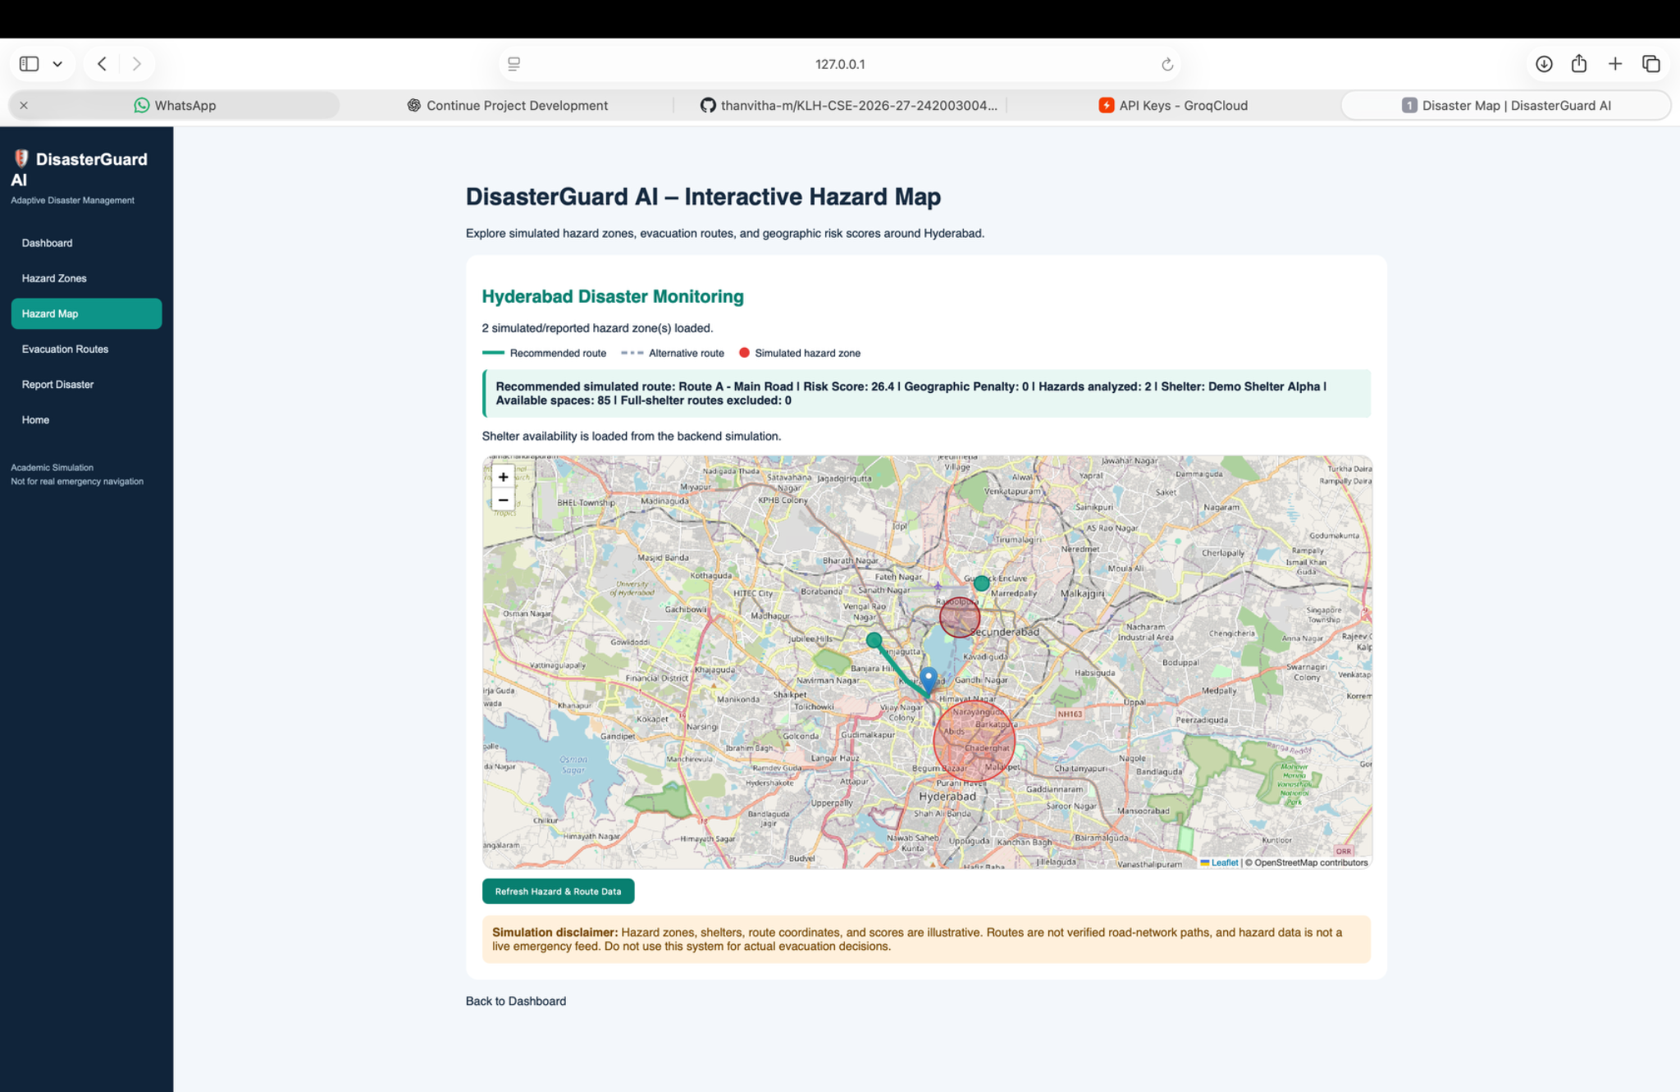
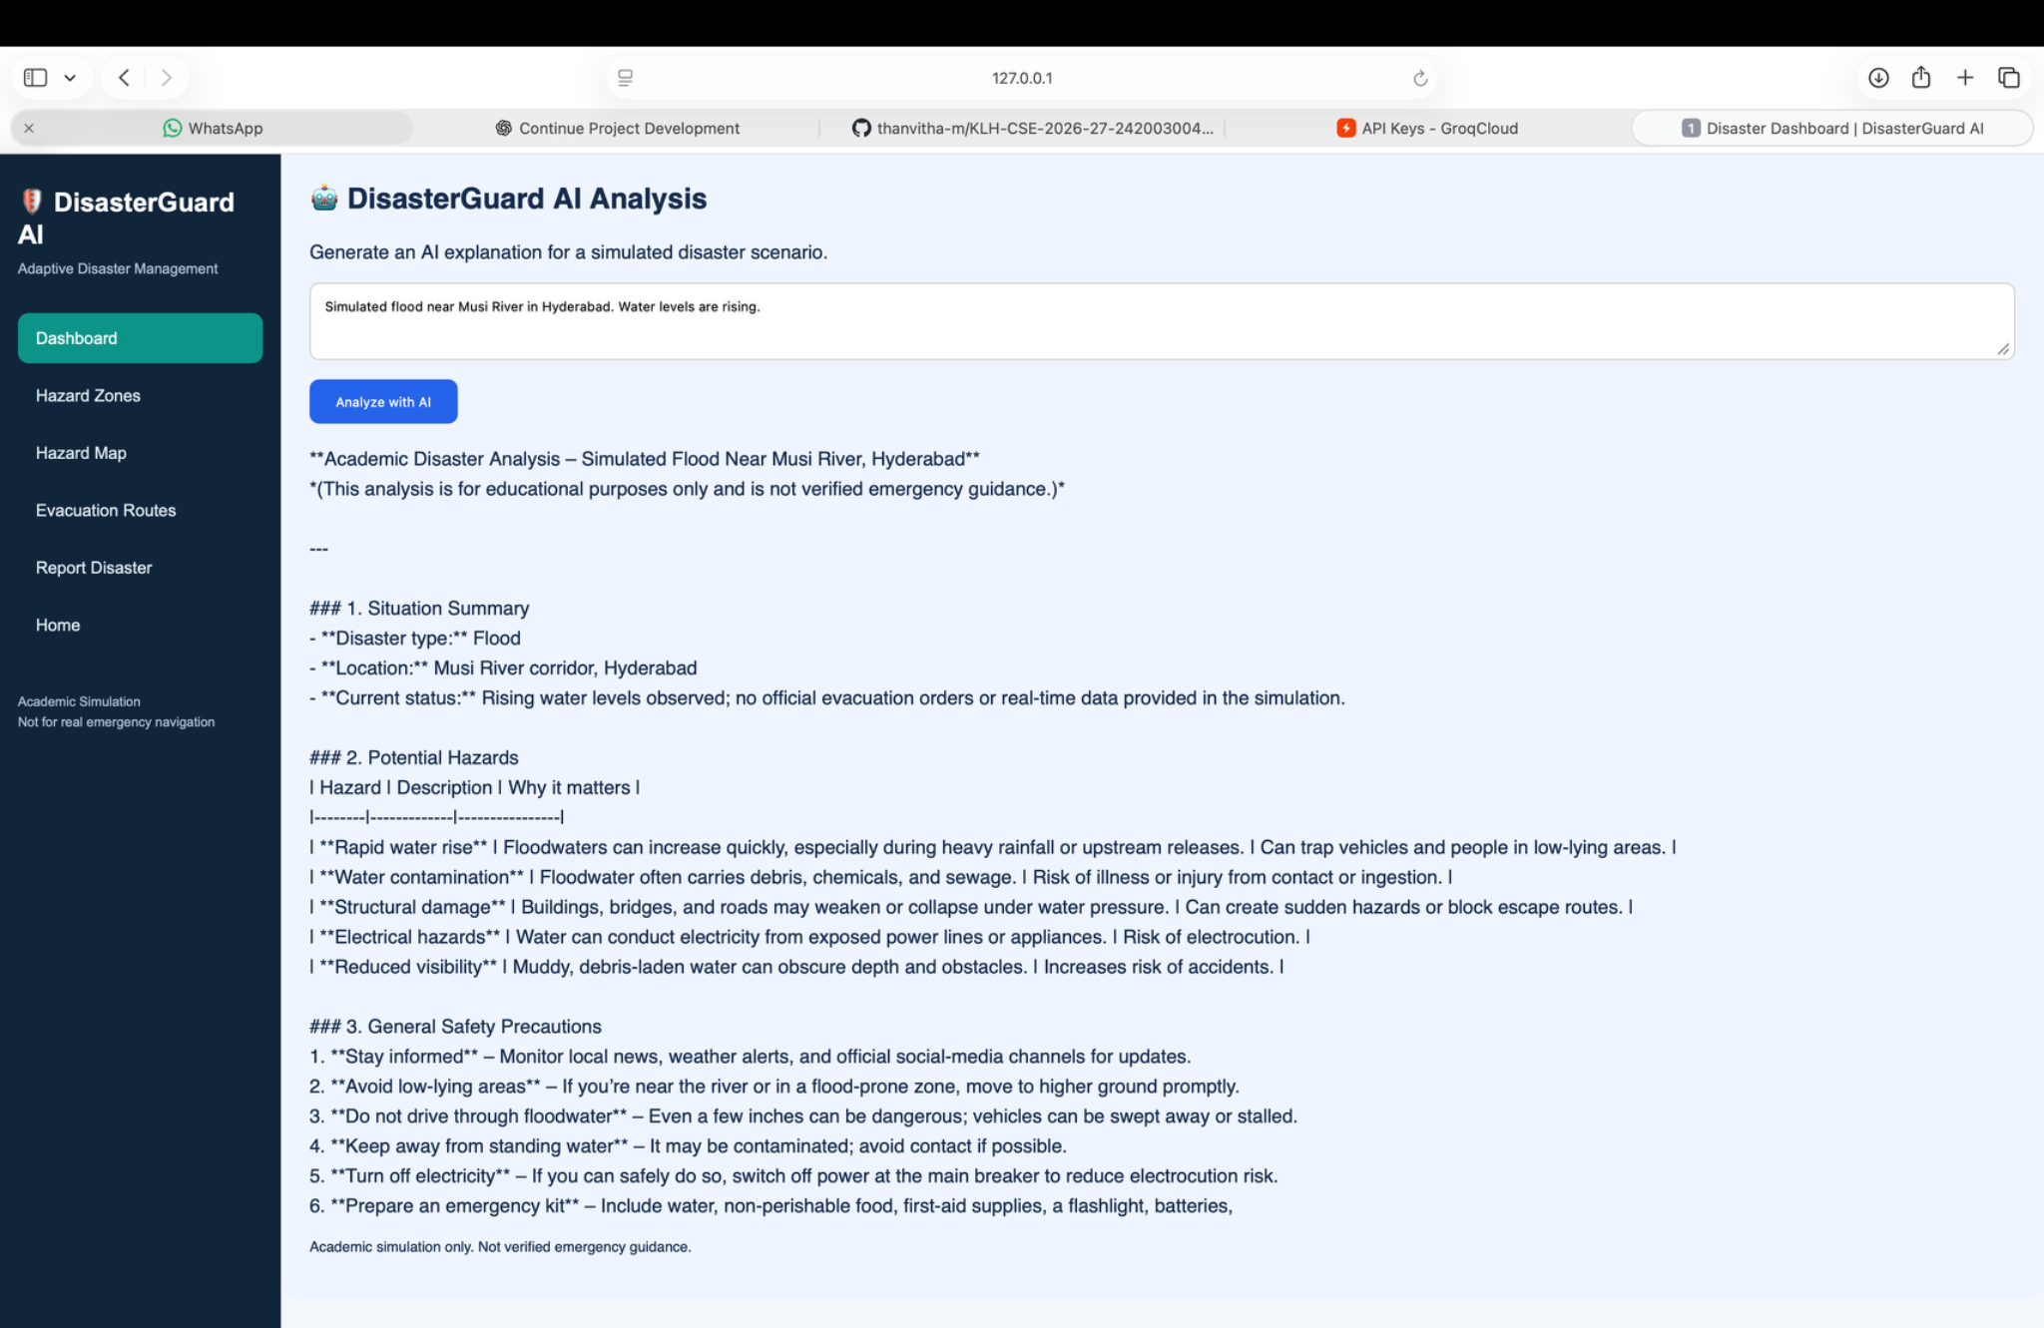
Implementation / Progress
Interactive Hazard Map
Groq AI Disaster Analysis
Verified progress: 18/18 Pytest tests passed locally • FastAPI AI endpoint returned HTTP 200 • Flask dashboard displayed generated analysis • Latest AI integration commit: 0a7abd9.

Slide 12
AI Integration – Groq LLM
Disaster input
Backend API
Hosted LLM
AI response
→
→
→
Flask dashboard
FastAPI endpoint
Groq / GPT-OSS 20B
Summary + hazards
• A real hosted language model generates scenario-specific disaster analysis.
• It explains supplied route information but does not calculate or verify routes.
• Output is labeled as an academic simulation, not emergency guidance.
Live demo: Dashboard → Analyze with AI → Generated response

Slide 13
Adaptive Software Engineering – MAPE-K
M · Monitor
Read stored hazard zones
A · Analyze
Compute geographic route risk
P · Plan
Rank routes; check shelter capacity
E · Execute
Refresh displayed recommendation
K · Knowledge
PostgreSQL data + scoring rules
Adaptation is request-triggered; this is not continuous autonomous monitoring.

Slide 14
Testing & Results
Automated backend tests
18/18 passed locally (Pytest)
LLM API integration
HTTP 200; Groq generated analysis
Flask–FastAPI integration
Dashboard AI request returned success
Adaptive route scenario
Critical simulated hazard near Route B → Route A selected
Version control
GitHub main: AI integration commit 0a7abd9
GitHub Actions workflow exists; latest CI run must be verified before claiming it passed.

Slide 15

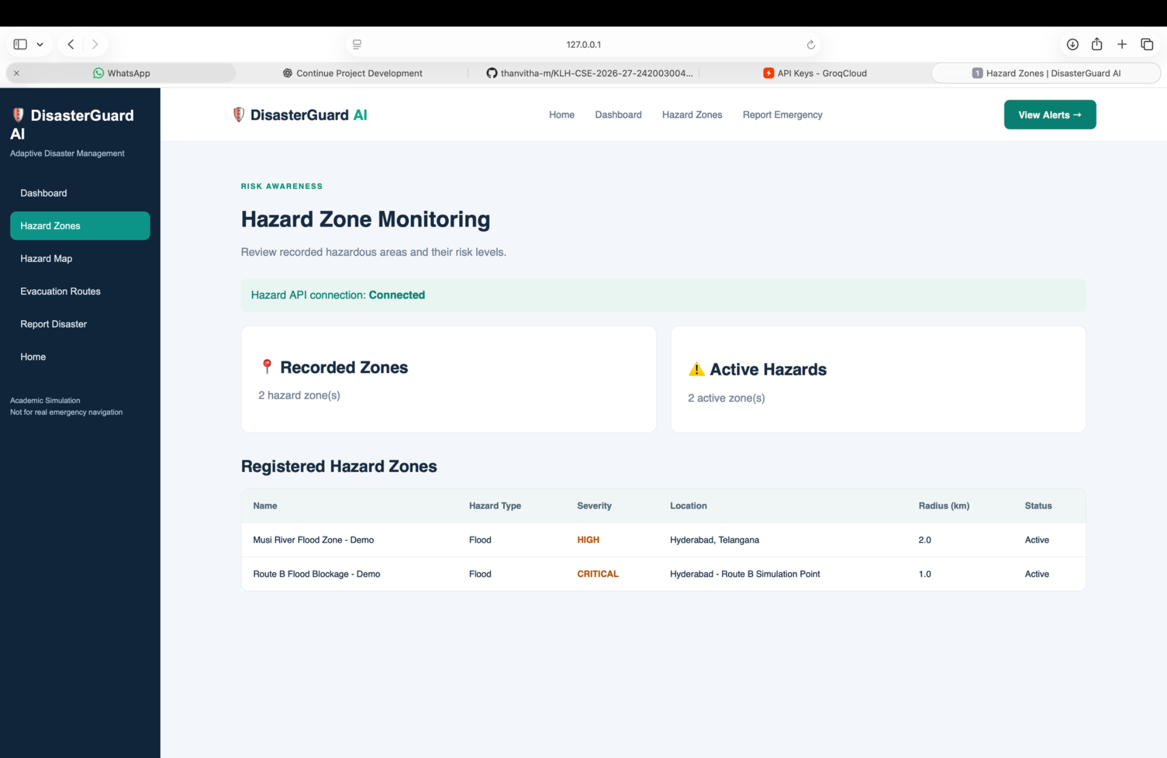
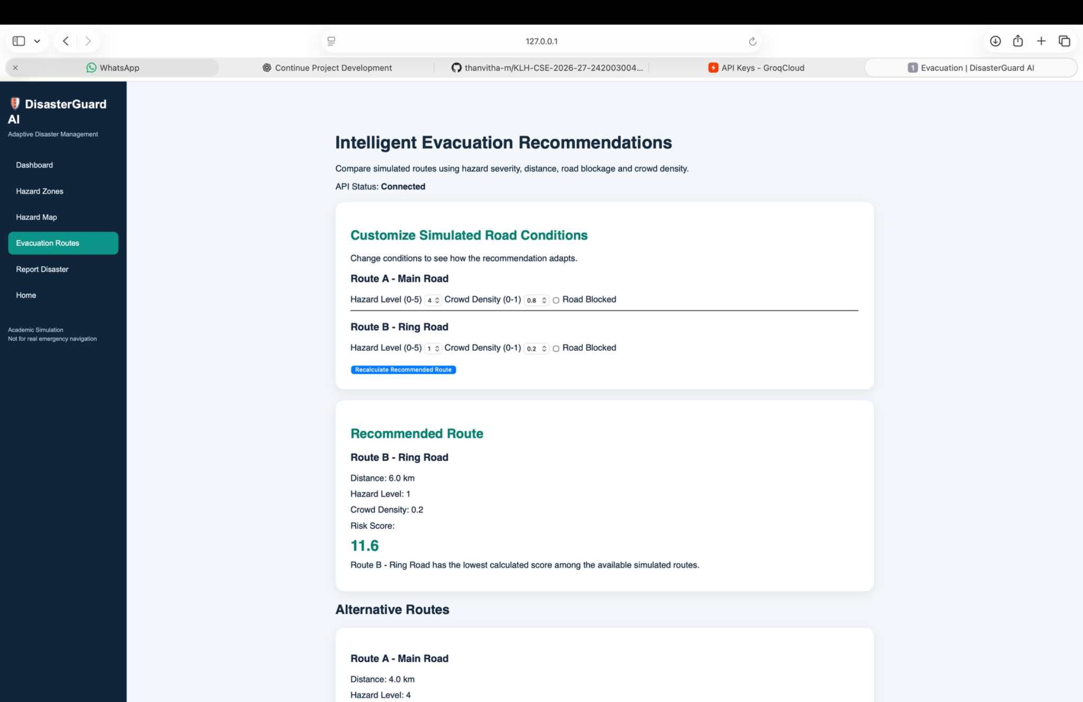
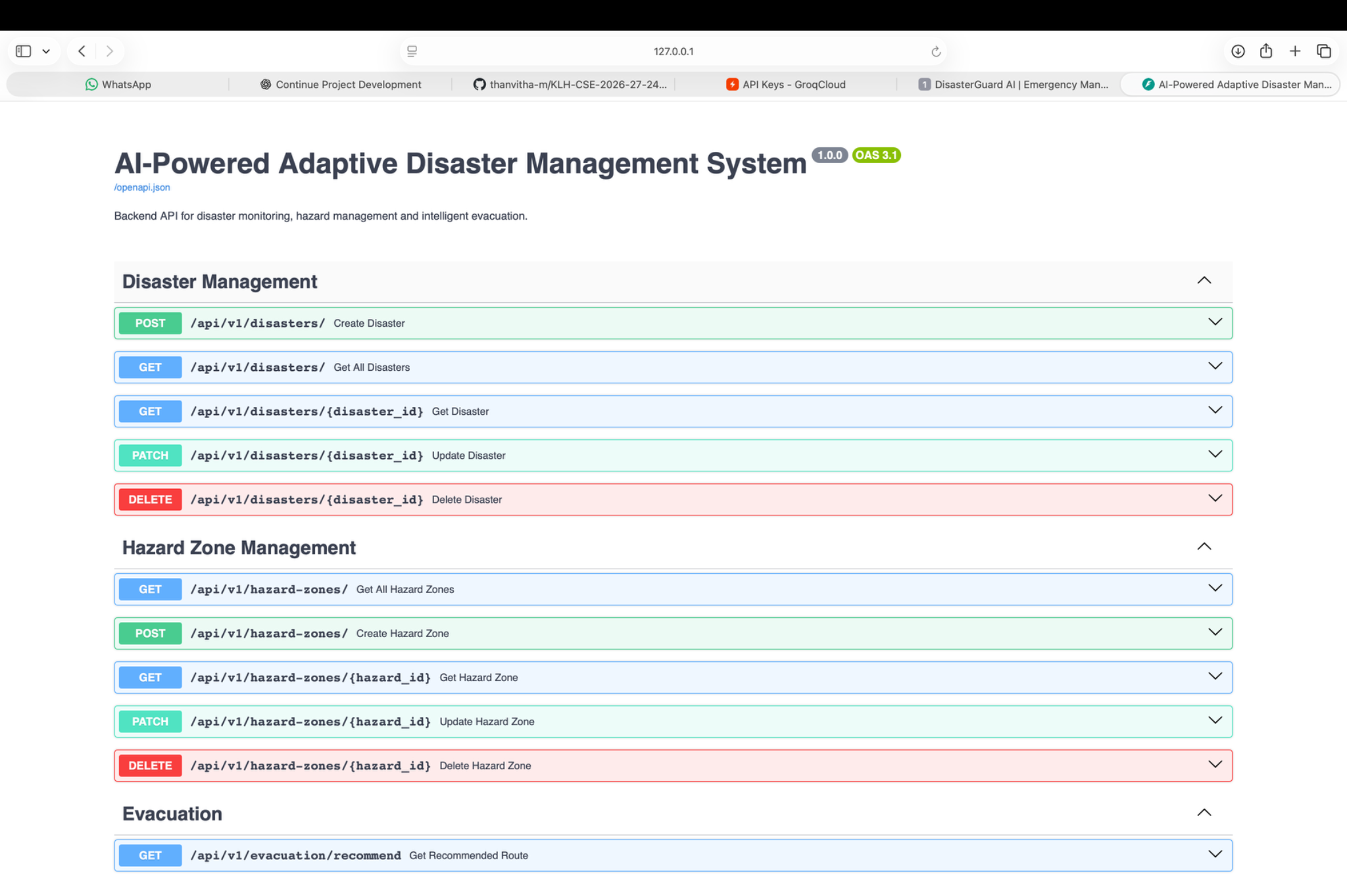
Evidence Screenshots – Paste Before Presentation
Unified Home Page
Hazard Zone Monitoring
Adaptive Evacuation
FastAPI Swagger API

Slide 16
Conclusion
DisasterGuard AI demonstrates an integrated academic prototype with database-backed hazard records, a geographic risk-based adaptive evacuation engine, simulated shelter checks and a hosted LLM disaster-analysis feature.
The MAPE-K concept is represented by reading hazards (Monitor), scoring risks (Analyze), selecting an eligible route (Plan), displaying the recommendation (Execute) and using stored records/rules (Knowledge). Adaptation is request-triggered.
The Groq-hosted GPT-OSS 20B model produces summaries and general precautions; it does not control route selection.
All 18 backend tests passed locally. Hazard inputs, routes and shelters are simulated; the system is not verified emergency guidance.

Slide 17
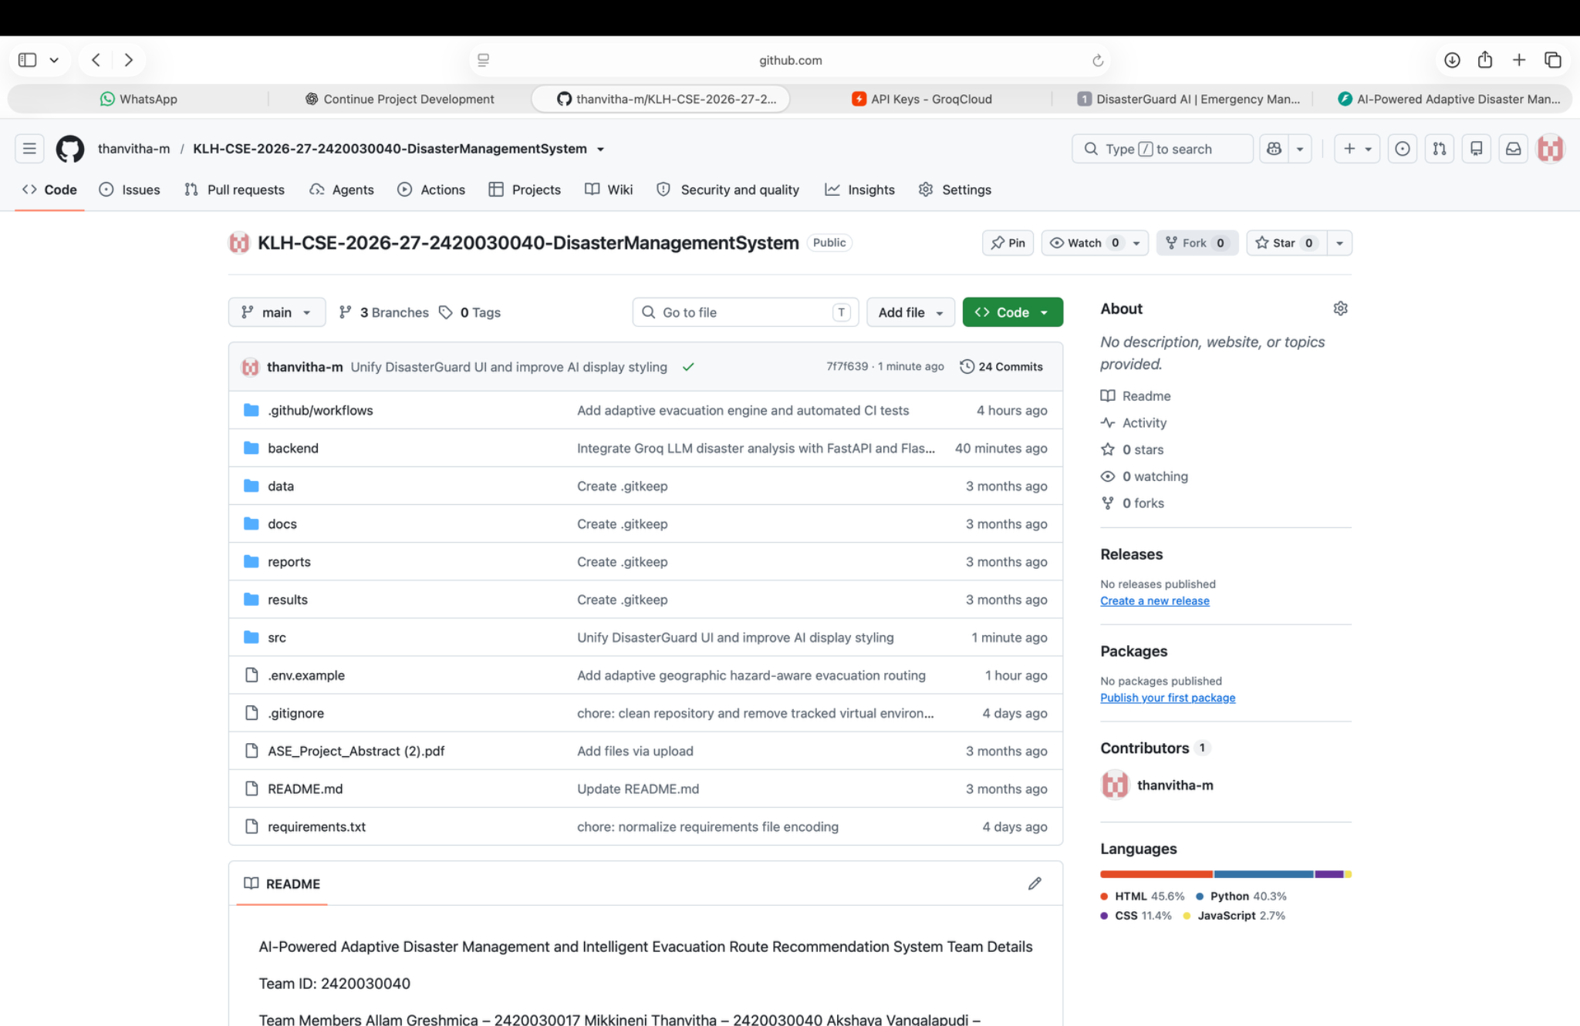
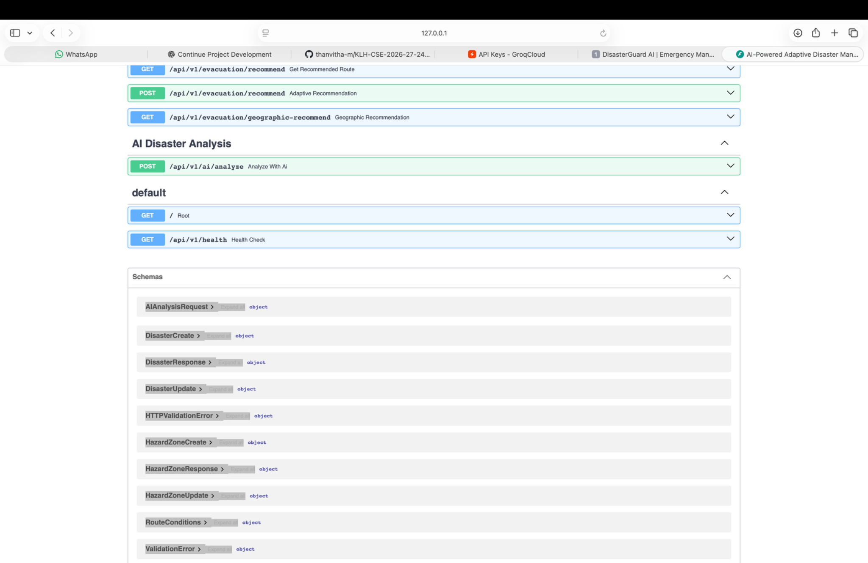
Development Evidence — Version Control & API
GitHub Repository — Updated Main Branch
FastAPI Endpoints and Schemas
DisasterGuard AI | Academic simulation • Screenshots from the working prototype

Slide 18
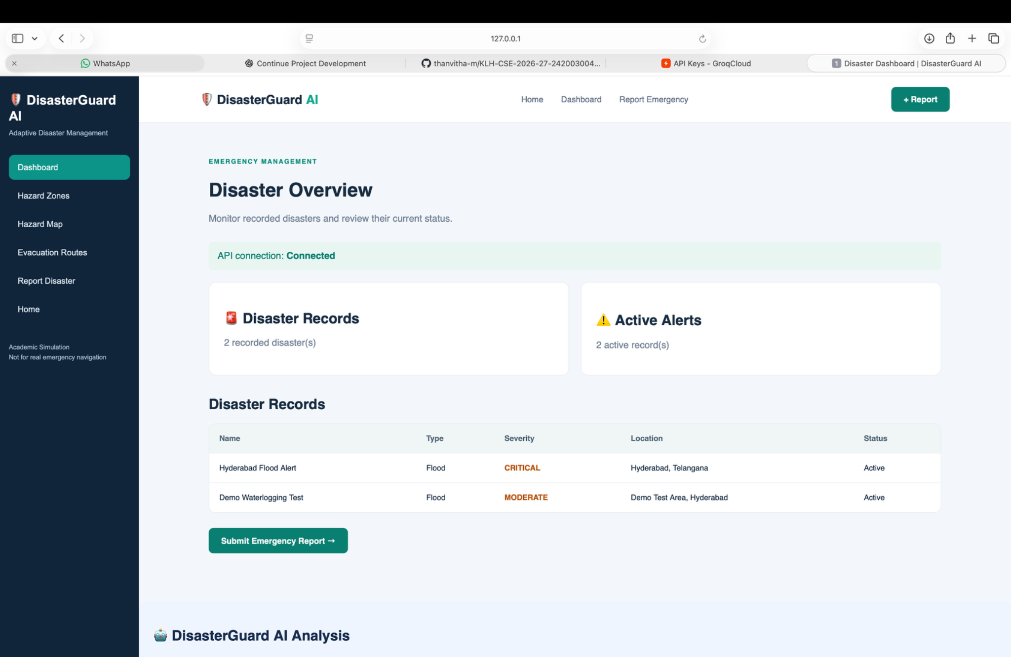
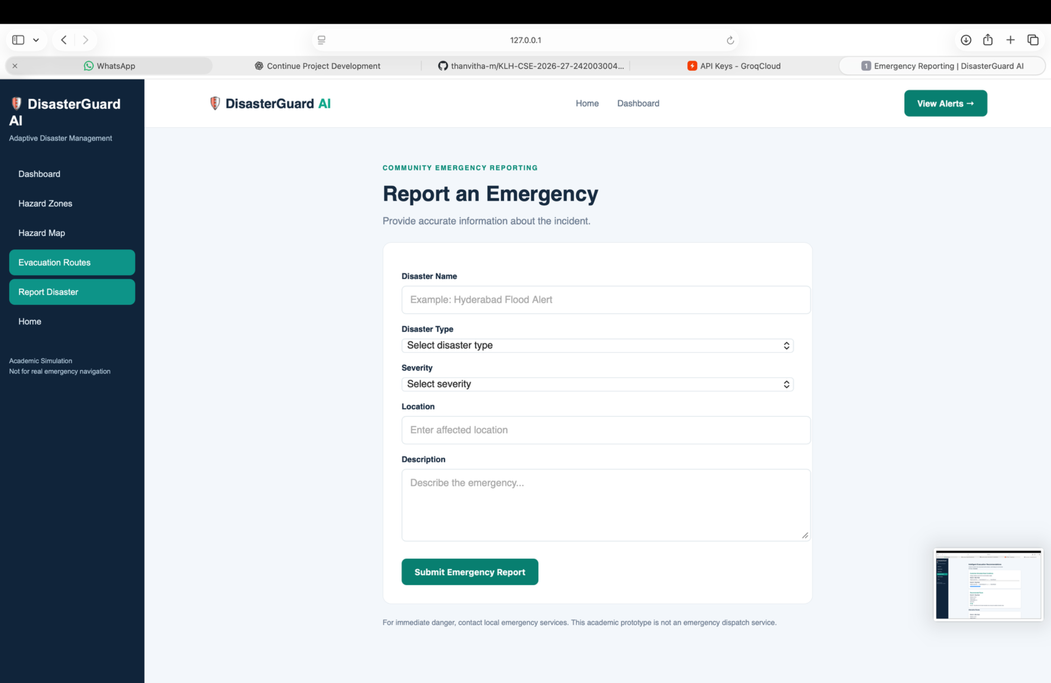
Application Screenshots — Core Workflow
Disaster Monitoring Dashboard
Emergency Reporting Form
DisasterGuard AI | Academic simulation • Screenshots from the working prototype

